Slide 1


Team 38: Virtual Try-On Clothing
Final Presentation Robin Martinez, Alan Vela, Jorge Olivares Sponsor: Pranav Dhulipala TA: Fardeen Mozumder
Notes:
Michelle

Slide 2
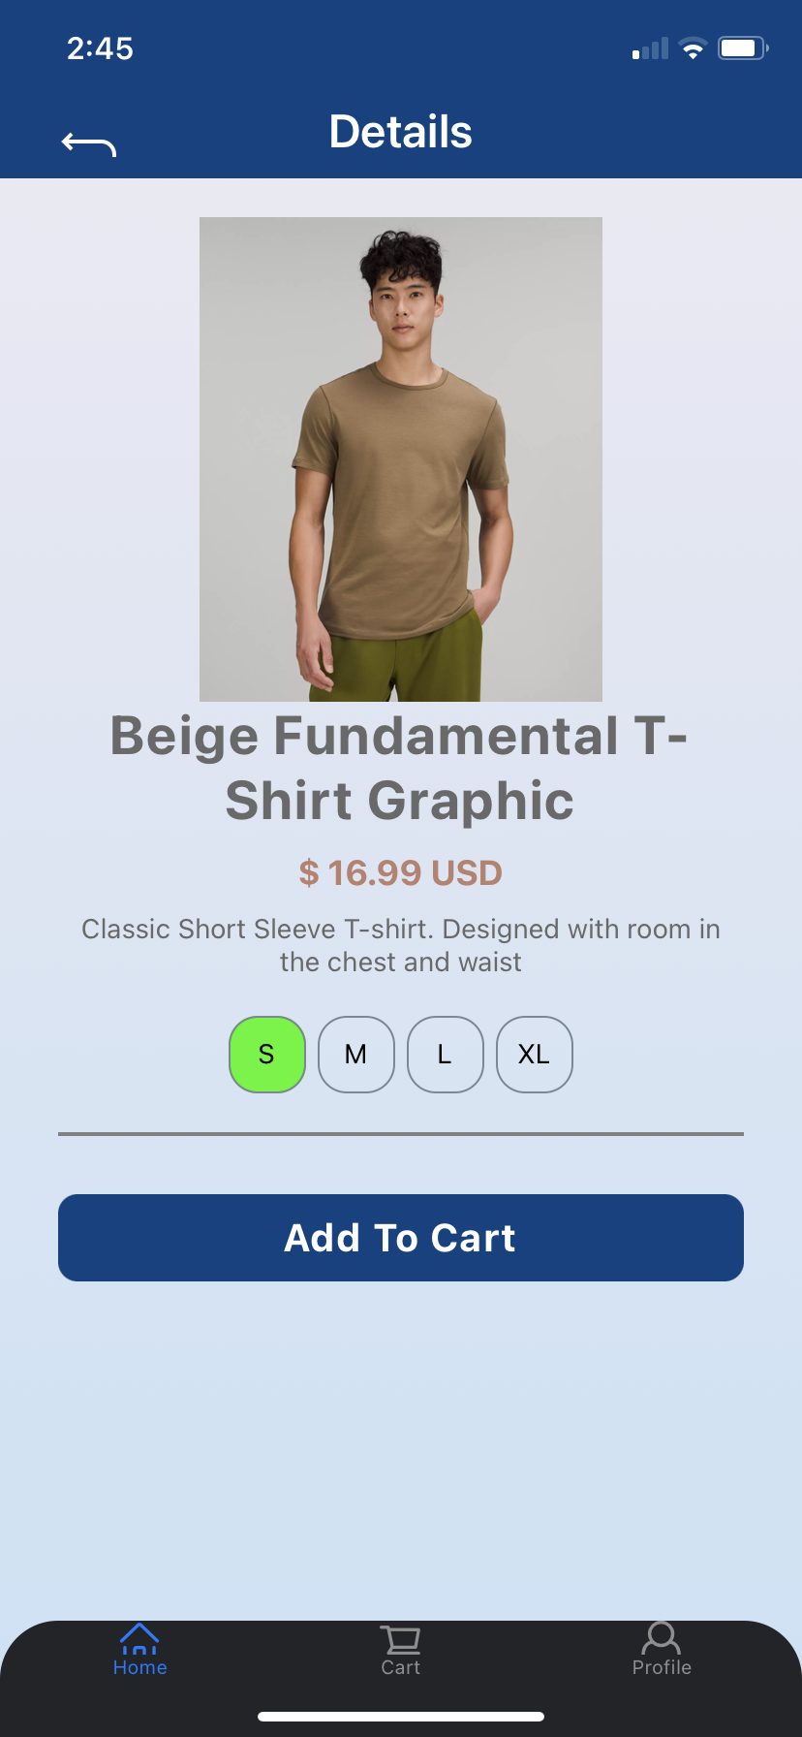
System Overview
Problem
Loss in revenue (returns, waste material)
Ease of Access
Customer retention
Proposed Solution:
Create accessible application for online shopping
Application creates 3D avatar that changes clothing

Slide 3
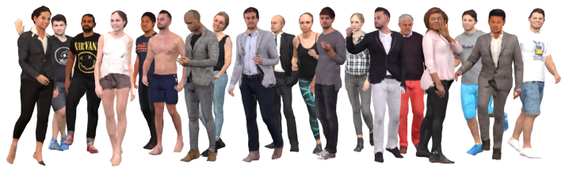
System Level Requirements
Android Based Application
3D modeling based off of Octopus model from “Learning to Reconstruct People in Clothing from a Single RGB Camera”
3D model must have interchangeable shirts and trousers

Slide 4
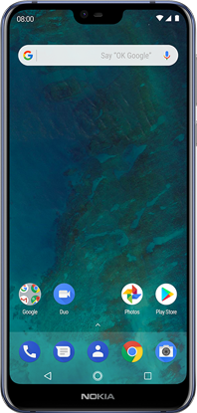
Block Diagram and System Breakdown
GUI Application:
Displays the user with the application
Uploads and receives user information to a database
Database Backend:
Stores the user’s information together with their avatar
Working Api for ML model communication with app.
Neural Network:
Receives a .mp4 video from the database
Returns a clothed 3D model of the user in .obj format
Robin | Alan | Jorge
Neural Network
GUI
App
Design
Shape Representation
Convolutional Architecture
Database
Backend
Loss Function
Optimization

Slide 5



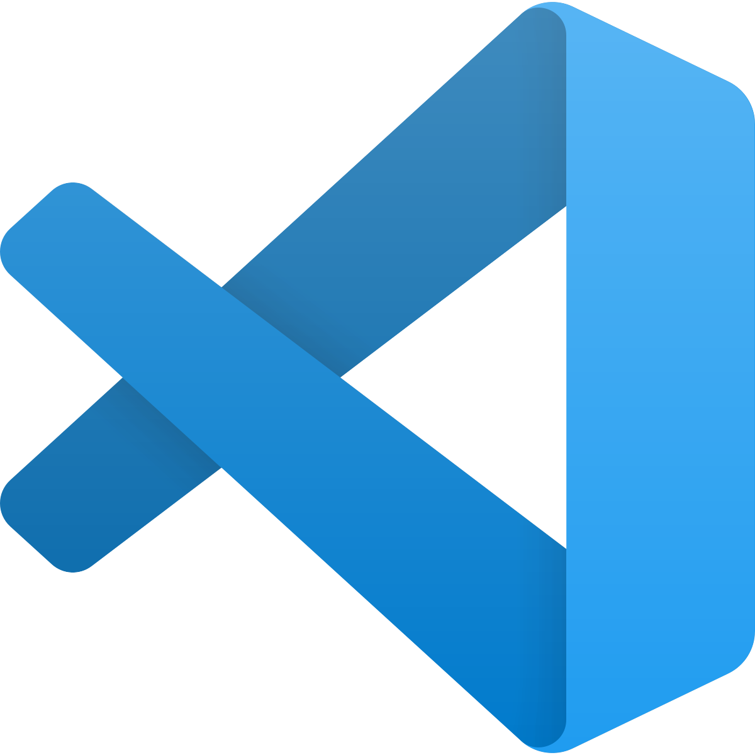

GUI Application - Alan Vela
Created application using React Native
User able to upload video to database
Application able to display avatar

Slide 6
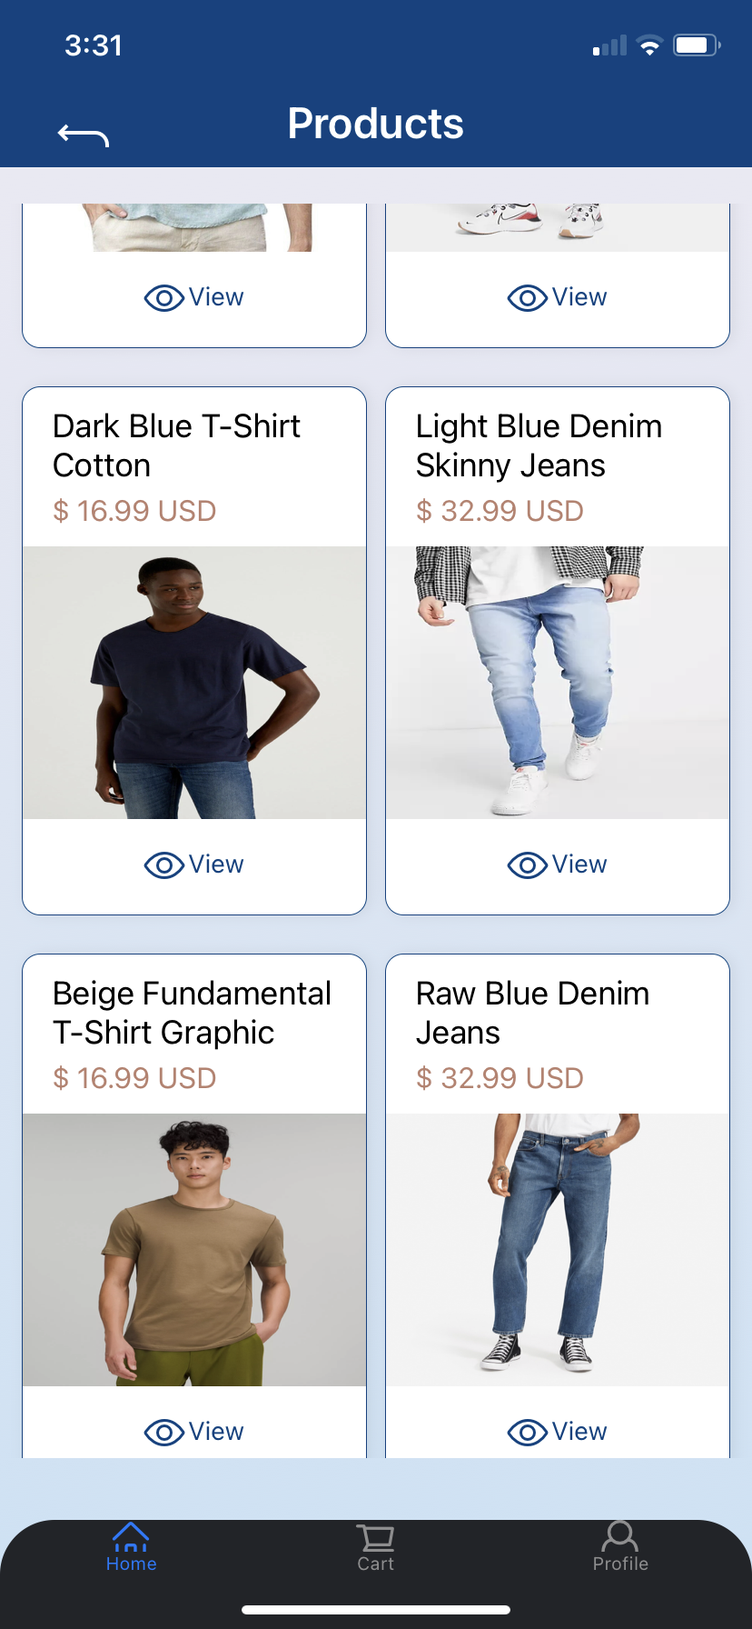
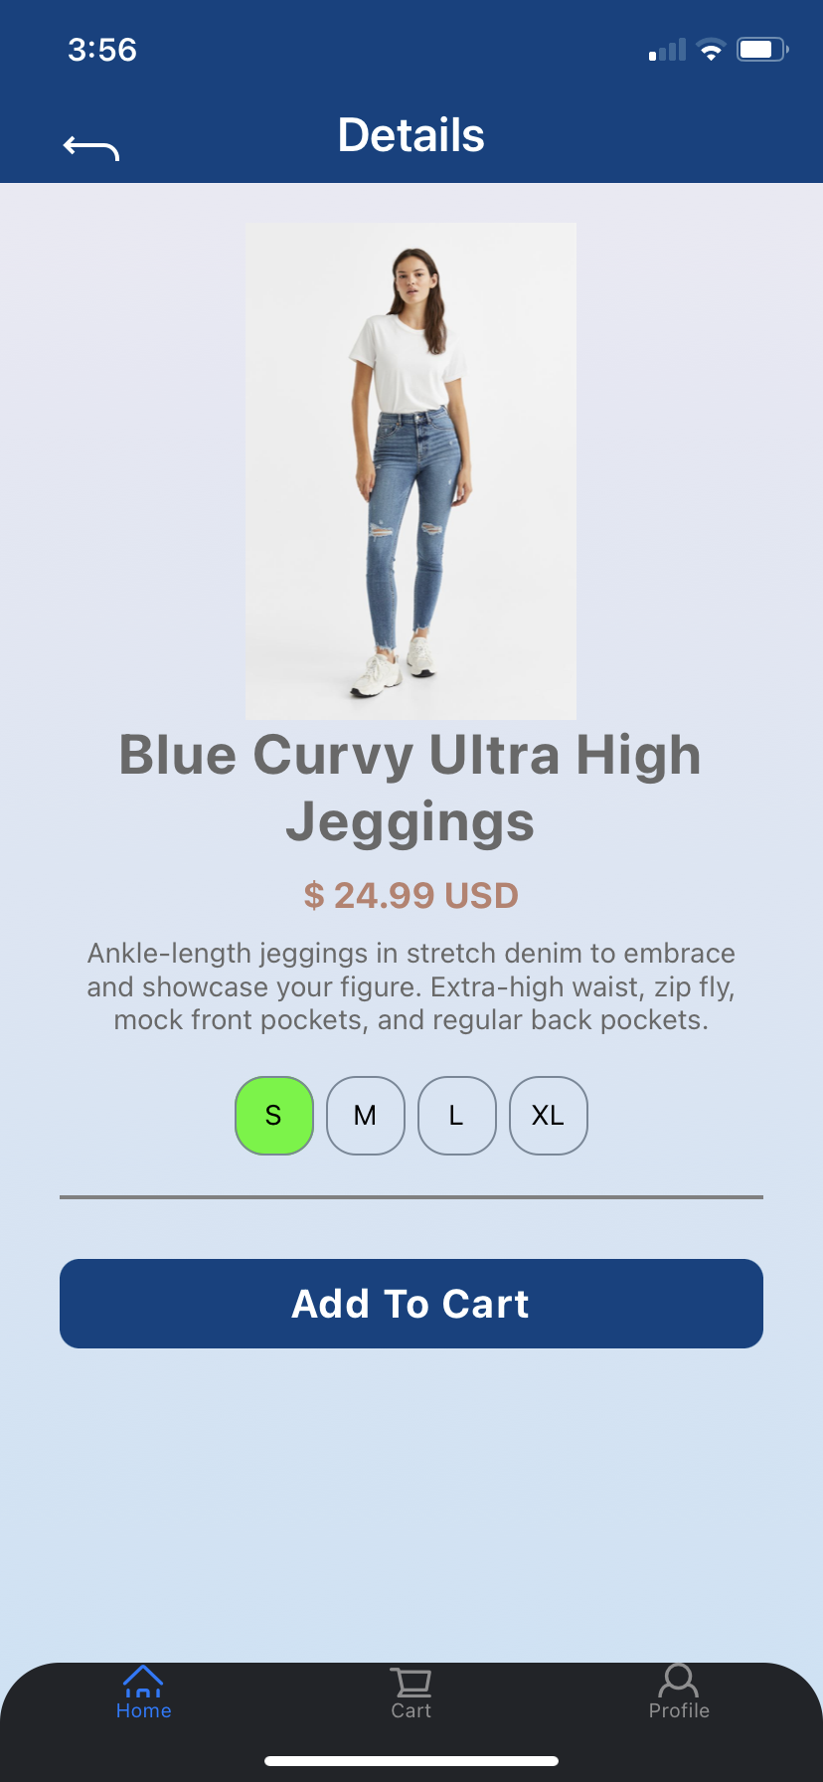
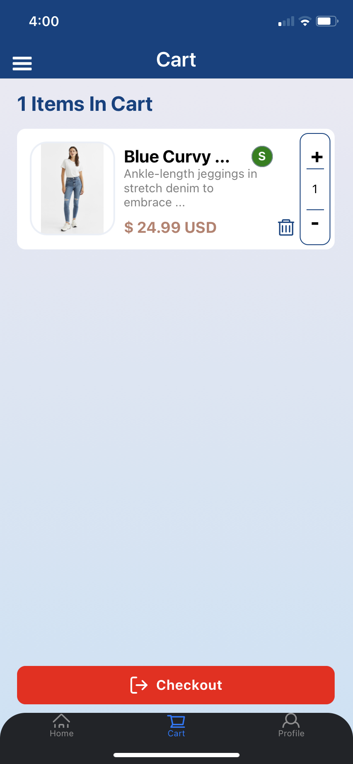
GUI Application - Alan Vela

Slide 7
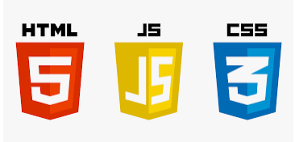
GUI Application - Alan Vela
Challenges
Started with Android Studio
Displaying video
Displaying Avatar
Learning Kotlin, Javascript, HTML, CSS
Solutions
Switched to React Native
Used updated packages i.e. document picker
Used Expo Gl & Expo Three
Using open source githubs and youtube tutorials

Slide 8
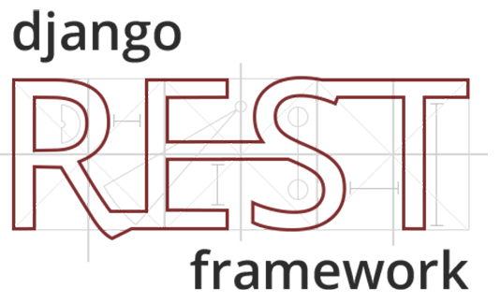

Database Backend- Jorge Olivares
Used DJango for communication services
Authentication process
Model and serialization for products
Stored data in JSON file

Slide 9
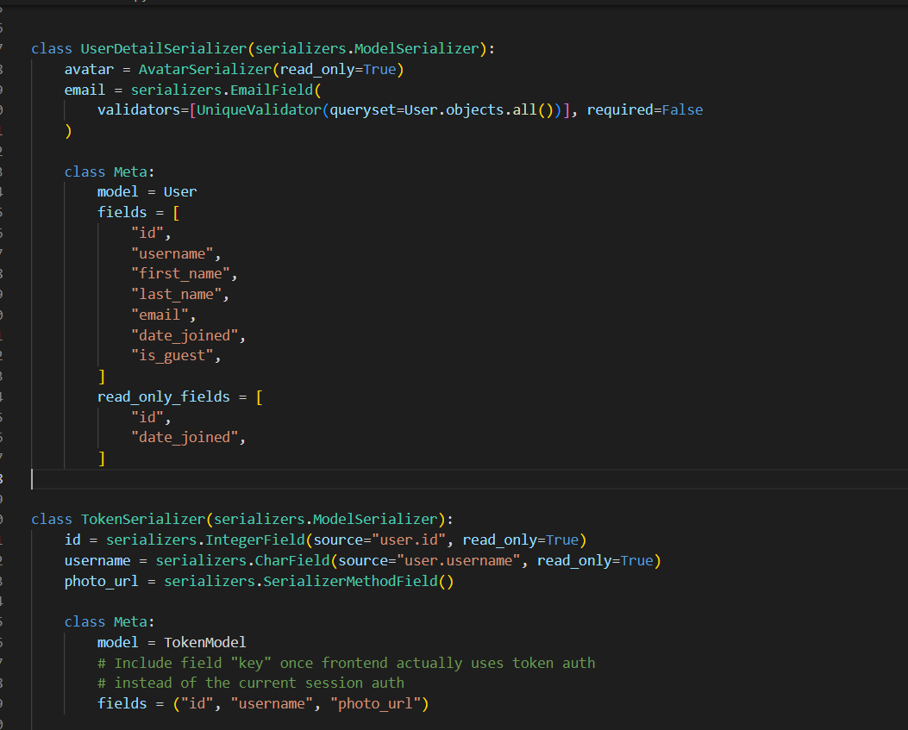
Cloud Database
Challenges
Database not connecting to the application
Application reading and writing data to database
Machine learning subsystem integration
Solutions
Creation of new application in React Native

Slide 10
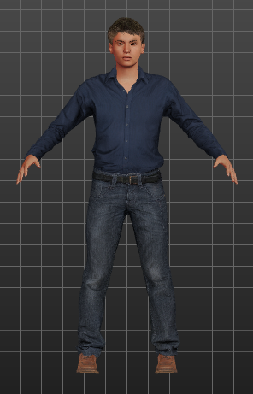
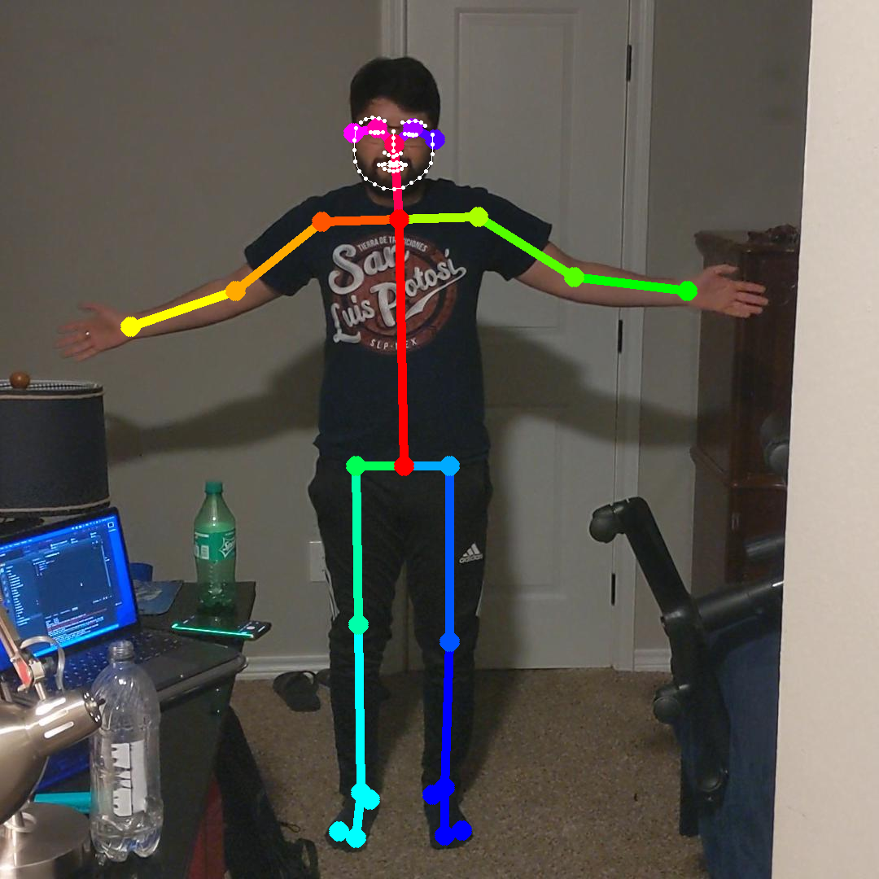
Machine Learning - Robin Martinez
Data preparation. Open Pose and Semantic Segmentation
Virtual Environment containing Octopus
Runs demo but crashes

Slide 11
Machine Learning - Robin Martinez
Challenges
Setting up a container on Olympus, permissions issues
Hardware issues, not able to connect to university
Solutions
Bypass home directory, created container in /mnt/shared-scratch
Upgraded to a newer computer model

Slide 12
Integrated System Results
Application and database able to connect, read/write, and display back on the application.
This includes profiles, profile images, clothing products, videos, and avatars
Machine learning subsystem not integrated with App and Database.
Excessive dependency issues (dirt and chumpy)

Slide 13
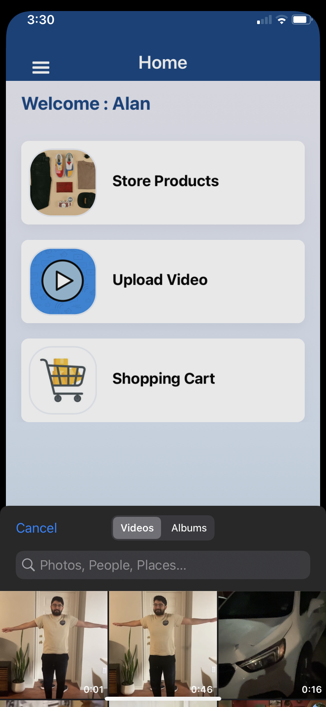
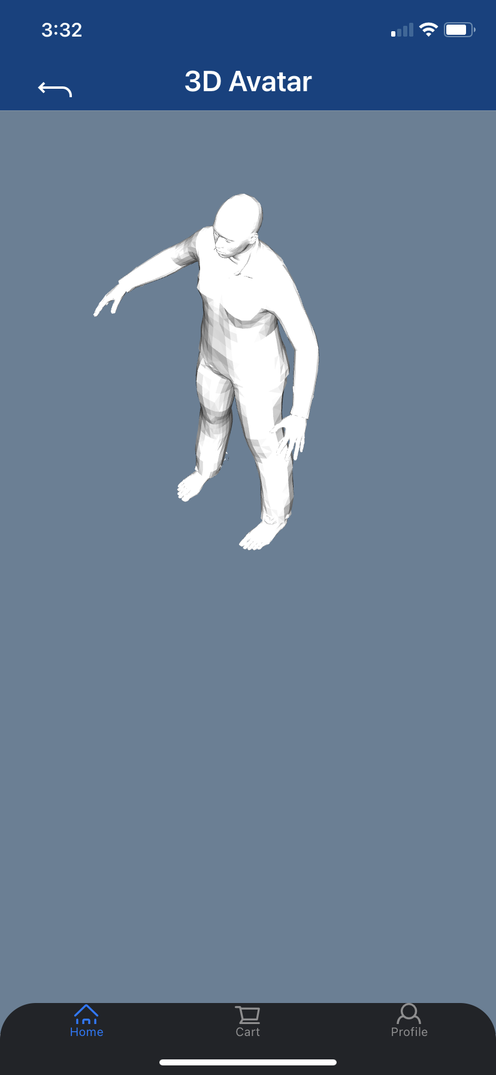
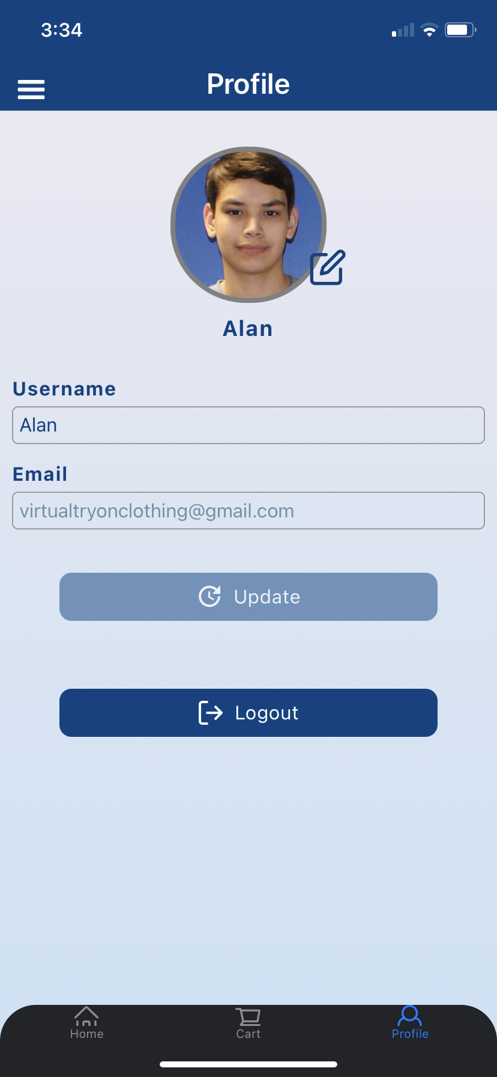
Integrated System Results

Slide 14
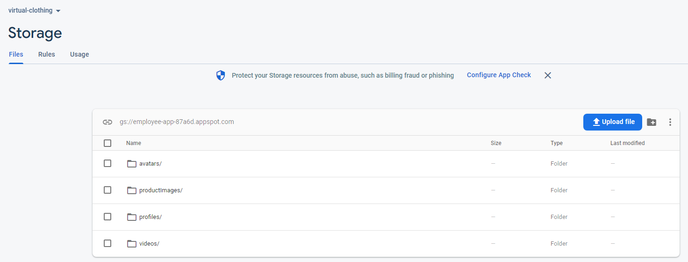
Integrated System Results

Slide 15
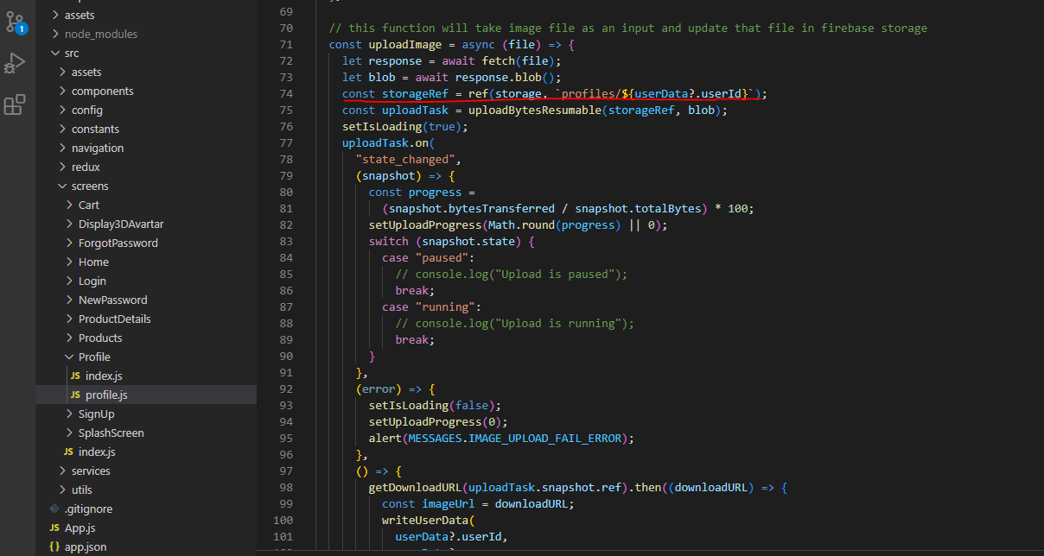
Integrated System Results

Slide 16
Conclusion
Built application for android/ios using React Native
Application able to save products, profile images, upload videos, and avatars to database
Octopus loaded into a python 3 virtual environment but crashes when ran via demo
Time management and communication skills.
Utilizing open source projects and online resources to create solutions

Slide 17
Project Mitigation
Advised to create a virtual environment in Python 2 to produce a deliverable
Issues with database video size limitations
Request smaller size videos

Slide 18
Questions?

